Slide 1
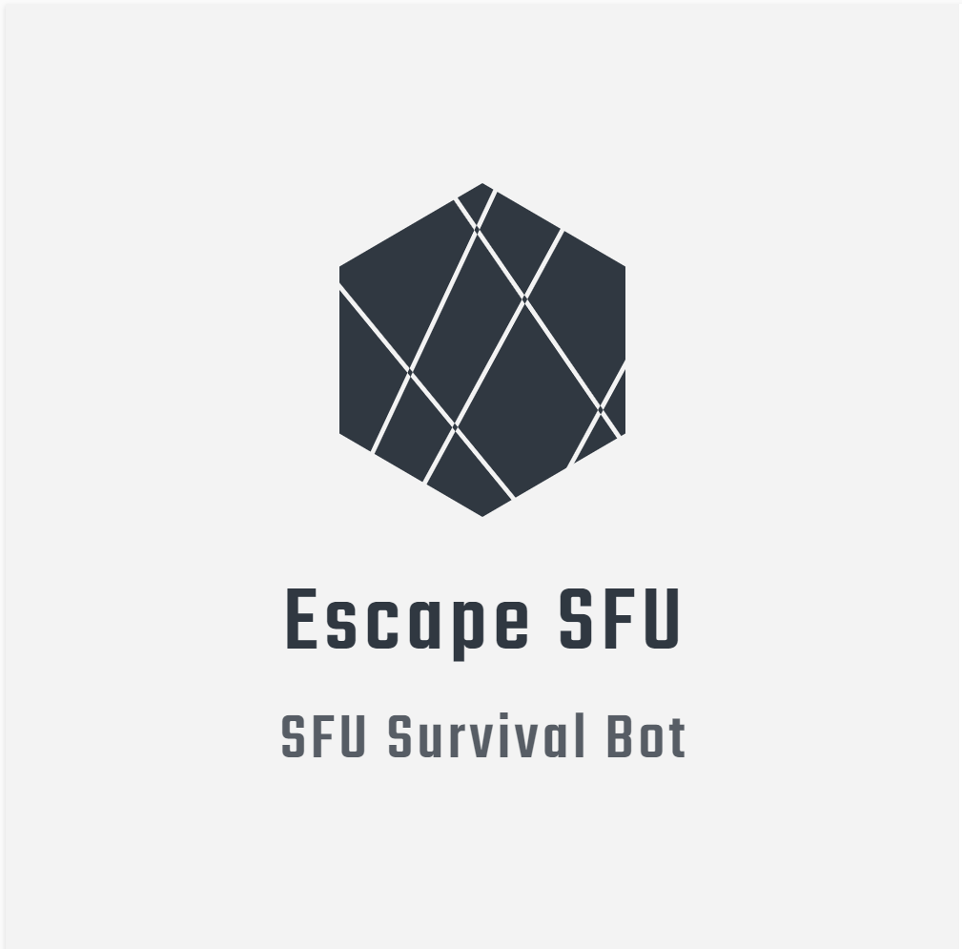

Slide 2
Problems Facing

Slide 3
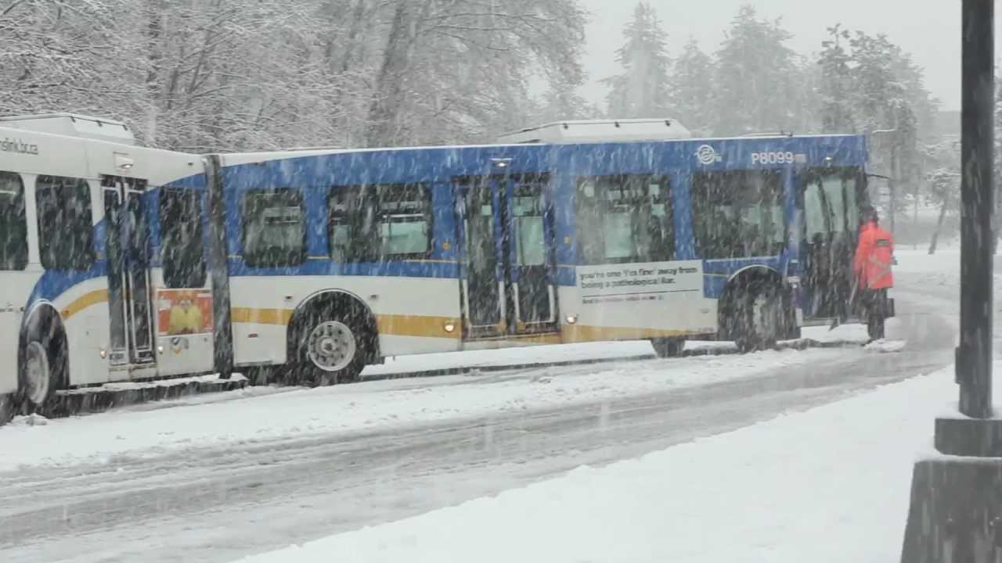

Slide 4
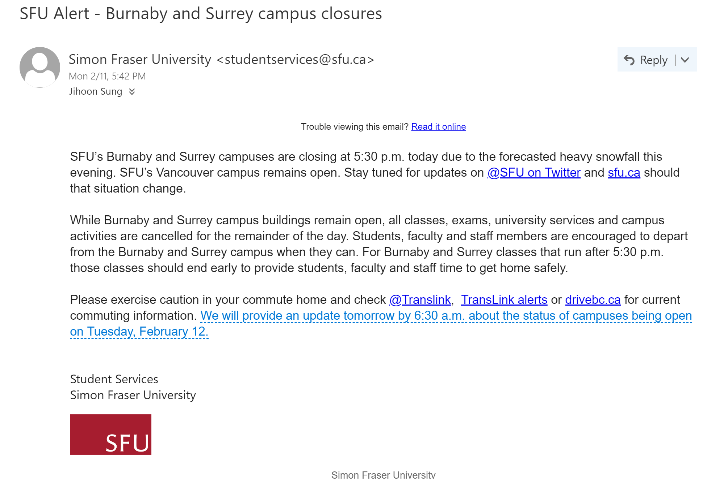

Slide 5
Problems Facing
SFU being located on top of mountain
Commuter School
More snow compared to rest of Metro Vancouver
Closing last minute
Being stuck on campus
Have to check Transit, campus, road status separately

Slide 6

Solution: SFU SURVIVAL BOT
Discord Bot
Current Userbase
Supporting following functions:
Weather Status
Bus Status
Library Hours
Road Conditions
Ride Share
Use by sending messages to the bot

Slide 7
SFU SURVIVAL BOT - Implementation
Based on Node.js
Using discord.js module
Utilization of
SFU Data Hub Public APIs
Translink API
RTTI Open AP
Forecast.io API
Cheerio Web Scraper
HTML Data Collector

Slide 8
DEMO

Slide 9
Things to Improve
Integrate machine learning for a more intuitive and natural conversation between bot and user.
Add escape alert by adding a computer vision module to let people know when to leave the campus.
Add scalability and improve performance

